Slide 1
Predicting SLA Breaches in IT Incident Management Systems

Slide 2
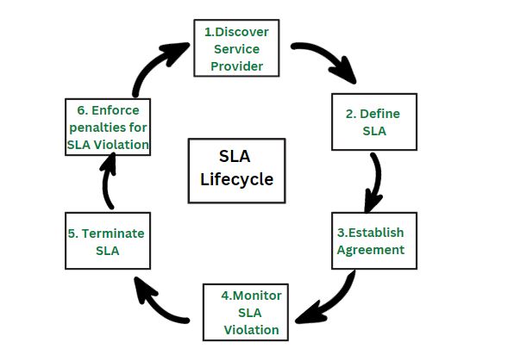
Problem Context and Dataset Relevance
Problem Statement
Service Level Agreements (SLAs) define response and resolution deadlines for IT incidents.
When breached, they cause operational inefficiency and customer dissatisfaction.
Objective
Prepare and analyse a large-scale incident dataset to identify workload and timing factors that lead to SLA failures.
Dataset Overview
  Source: Kaggle – Incident Event Log Dataset
  Size: 141 712 records × 37 columns
  Scope: Incident lifecycle – creation → assignment → resolution → closure
Relevance
The dataset captures real service-desk operations—perfect for studying ticket flow, workload complexity, and SLA compliance within an MLOps context.

Slide 3
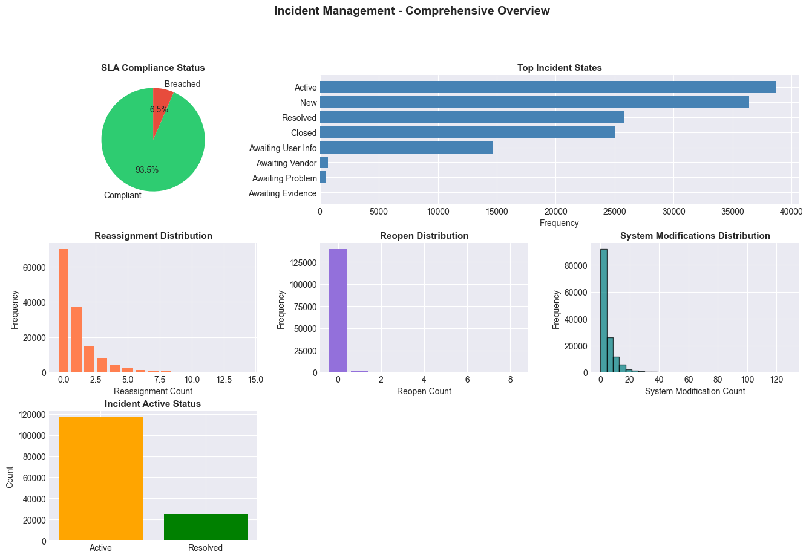
Dataset Exploration
Structure Insights
  Incident states: 9 types (New, Active, Resolved, Closed …)
  SLA success rate: 93.5 % | breach rate: 6.5 %
  Numeric metrics: reassignments, reopens, modifications
  No missing or duplicate entries detected
Initial Observations
  High reassignment and modification counts often accompany breached tickets, implying operational bottlenecks.

Slide 4
Data Cleaning and Feature Construction
Preprocessing Steps
Converted timestamps (opened_at, resolved_at) → datetime
Normalised boolean fields (active, made_sla) to 0/1
Verified no duplicates or missing entries
Feature Engineering
Temporal fields: open_hour, open_day, open_month
Target: sla_breach (1 = breach)
Derived metrics: workload_score, complexity_flag, reassigned, reopened
Encoded categorical columns and scaled numeric values

Slide 5
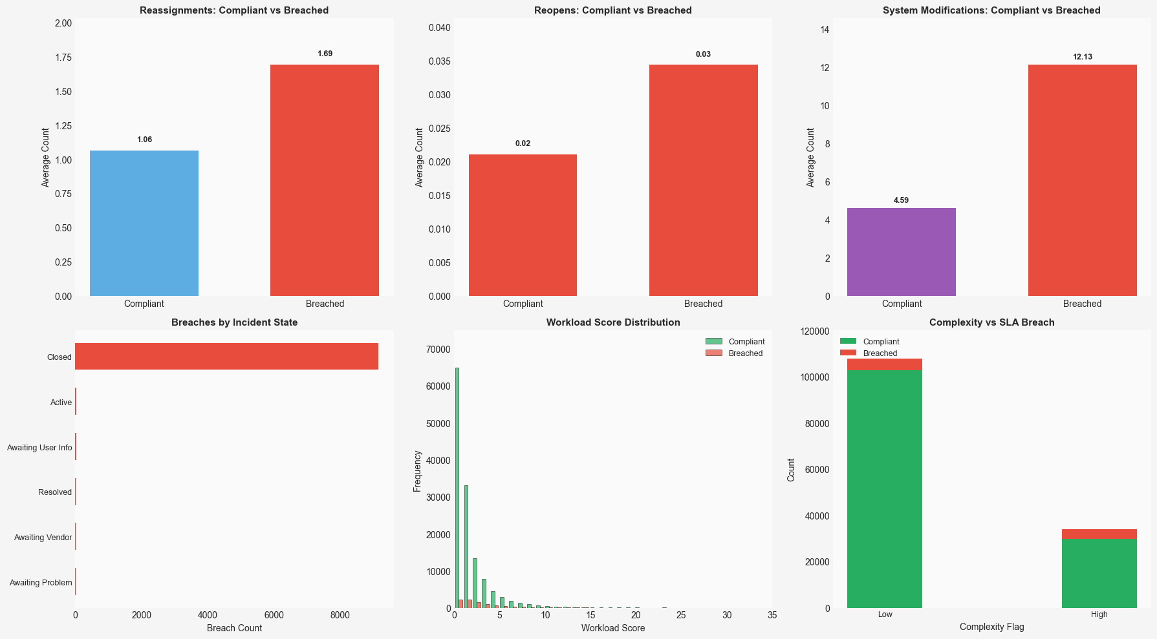
Insights and Outcome
Key Findings
Breach likelihood increases with reassignment and reopen frequency
Complex tickets are ≈ 3× more likely to violate SLA
Most breached tickets close reactively → late resolution
Temporal factors (Feb 2016 – Feb 2017) show stable workload trends
Final Dataset Summary
After processing, the dataset achieved full analytical readiness with:
141 712 records, 50 features, 6.5 % breach rate

Slide 6
Thank You

